Slide 1
Connect on Wheels
Continue life

Slide 2

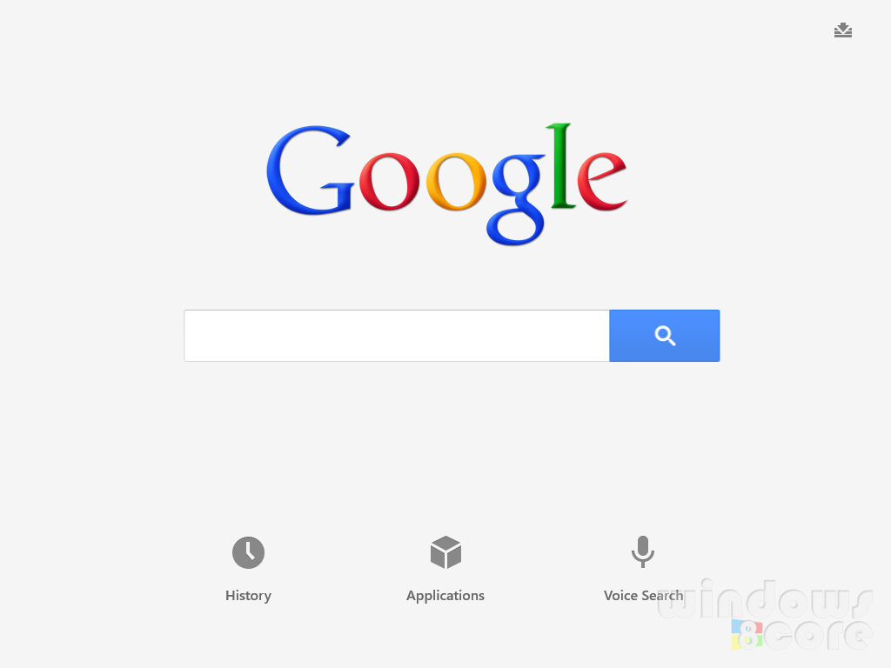


Seamless wireless connectivity
Use your own device, login with your favourite social network and start browsing at 4G speeds!
Conserve battery and save money by using WiFi instead of your 3G network.

Slide 3
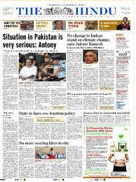


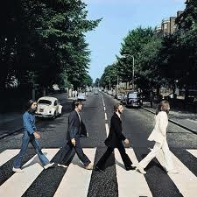

Access content to your heart’s content

Slide 4

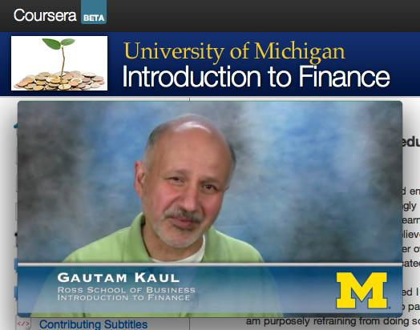
Learn on the go

Slide 5
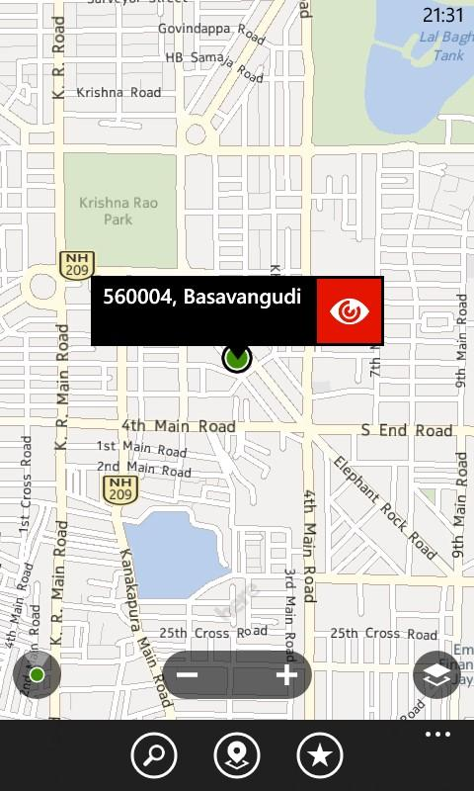
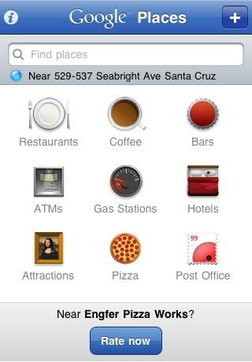
Let your loved ones know where you are
Find things to do wherever you are going...
Tweet location

Slide 6
Connect with your fellow travellers
Where can I find authentic cuisine in Bangalore?
You need look no further than MTR!
Cheers! I am Tej btw...
Priya. Nice to meet you!

Slide 7

And there’s more to come...

Slide 8
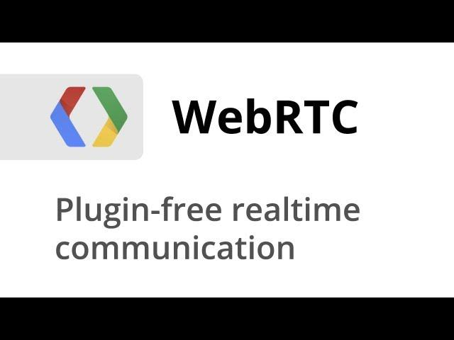
WebRTC

Slide 9
Use WebRTC to enable...
P2P gaming
Calls to phones
Calls to other devices
Messaging (Plivo?)

